Slide 1
2º International Seminar of Sustainable Public Procurement, Brasilia, Brazil
Sustainable Public Procurement:
engaging the market and the supply chain
Dr Mervyn Jones
Head of Collaborative Programmes
28th August 2014
Notes:
Hello, my name is Dr Mervyn Jones.
Ladies & Gentlemen, I haven’t come over to this conference to tell you how to ‘do’ sustainable procurement in Brazil. I have however come to share how we have been approaching sustainable procurement in the European Community.
I hope you will be able to recognise some common factors and be able to benefit from some of our approaches just as I have benefited from yesterday’s conference presentations.
At WRAP we’ve been working for around 7 years on a variety of activities relating to sustainable public procurement in the UK and more recently, linked to the development of the UNEP Marrakech Task Force to SP. The Marrakech Task Forces (MTFs) were country-led initiatives being part of the Marrakech Process, which respond to the call of the Johannesburg Plan of Implementation from 2002 to develop a 10 Year Framework of Programmes 10YFP). In the UK, Defra led the UK development through our work at WRAP.
The examples and case studies I will use are picked especially as examples that can, and have been replicated in other countries, e.g. in Europe and in the USA and South East Asia.

Slide 2
Our vision
WRAP is working towards a world where resources are used sustainably.
We focus on the most important challenges, domestically and internationally, where we can make the most difference.
Notes:
WRAP is an independent, not-for-profit company, recognised in the UK and internationally for our expertise in resource efficiency and product sustainability, our leading-edge evidence, our skills and knowledge, and our ability to bring people together to solve problems.
We help governments, businesses, individuals and communities reap the benefits of reducing waste, developing sustainable products and using resources in an efficient way.
Our key drivers are:
Product Sustainability – reinventing how we design, produce and sell
Behaviour Change – rethinking how we buy, use and consume
Waste & Resource management – redefining how we re-use and recycle

Slide 3


Sustainable procurement benefits
Cost saving
Environmental impact reduction
Supply chain developing REBMs
resource
efficient
procurement
increase supply chain resilience
Health, labour rights
Multiple CSR goals
Legislative pressure
Notes:
Public sector bodies have clearly defined goals to reduce greenhouse gases. Leadership in public procurement also means going beyond basic supplier compliance schemes. Leading organisations are already considering sustainability as an important strategic lever in place of traditionally cost focussed supply chain thinking, e.g. by implementing circular economy principles.
A circular economy provides an alternative to the traditional linear economy (make, use, dispose) in which we keep resources in use for as long as possible, extract the maximum value from them whilst in use, then recover and regenerate products and materials at the end of each service life. This increases resilience for both customers and suppliers and additionally contributes measurably to reduced environmental impact from procurement.
This is driven by various factors and has multiple benefits as the slide shows:
These factors will apply to different degrees in public (and private) sector procurement. Procurements adopting closed loop or more closed loop supply chains are better positioned to deal with these challenges.
It is important to emphasise that a SP policy or strategy is not a separate document but needs to be part of the overall organisation policy / strategy.
It also emphasises both the need to regularly review the Policy and Strategy to be relevant to current priorities BUT also the importance of illustrating to the whole organisation how important Procurement can be to assist their organisation in realising its ambitions.

Slide 4
Procurement value for money triangle
Improve the quality of public services and the ease of access for suppliers
Capability
Competitiveness
Capturing savings
& benefits
Coverage
Collaboration
Corporate Social Responsibility
Deliver savings & value for money
Communication
Buy sustainably
Notes:
SP is an integral part of improving quality of services delivered by public bodies and in achieving VFM
This slide simplifies the 7Cs – and the Key Strategic Priorities – Buy Sustainably pointed out here.
Procurement is a key means of delivering the Government’s priorities and underpins the achievement of the social economic and environmental benefits that sustainable economic growth demands.
Additional info if required:
Capability
We want to ensure that procurement activity and decision-making is conducted to the highest possible standard.
We want to ensure that effort is not duplicated, that resources are allocated where they will deliver the maximum benefit and that we continue to promote the exchange of best practice across sectors, organisations and individuals.
Competitiveness
Improved procurement must go hand in hand with improved competitiveness. We aim to develop and nurture our businesses, particularly SMEs, by making it as easy as possible for them to identify contract opportunities and for them to compete for those opportunities.
We want procurement to be open to new solutions and new suppliers with new ideas. While we cannot ignore opportunities for savings, we must ensure that local economic interests are protected and must only pursue larger contracts where these are necessary to deliver value for money for the taxpayer.
Capturing Savings and Benefits
We must measure and monitor progress closely to drive continual improvement.
This will be demonstrated by measuring and monitoring progress closely to drive continual improvement.
Coverage
We need to ensure that procurement reform has the widest possible coverage, in terms of organisations and forms of procurement and that key areas such as construction participate fully in improvement initiatives.
Collaboration
We must ensure that effort is not duplicated, that best practice is shared and we learn from each other. We also need to ensure that regional and local opportunities for collaboration are not overlooked, especially in relation to local economic issues and support for smaller public bodies
The public sector is working collaboratively, ensuring that effort is not duplicated, that we learn from each other.
Corporate Social Responsibility
We must ensure that procurement activity and the behaviour of those awarded public contracts conforms to the highest possible ethical standards and contributes fully towards combating climate change.
Communications
We must provide greater awareness of how procurement contributes to public services making best use of public money and on helping the Government achieve its overarching purpose of sustainable economic growth.
Effective communication is essential to the success of the programme. We need to ensure that the right target audiences receive the right messages at the right time. We also need to make sure that communications resources are put to best use and that effort is not duplicated.
4

Slide 5
Reducing impact of procurement
Impact category | Most significant service | Impact of most significant service as % of total impact | Key resource efficiency action in the most significant service
Materials consumed | Catering (supply of food) | 50% | Reduce avoidable food waste
Waste produced | Furniture (workspace furniture) | 50% | Product reuse
Energy and CO₂ in-use | Heating, ventilation and air conditioning (particularly heating) | 70% | Upgrading and refurbishment of equipment
Embodied CO₂ emissions | ICT equipment | 45% | Extending lifespan of equipment
Water use | Washrooms and kitchens | 90% | Reducing mains water use (e.g. flow regulators)
Cost | ICT equipment | 30% | Extending equipment lifespans
Notes:
Any procurement will have impacts – economic, environmental and social. In environmental terms SP is about reducing the negative impacts of our engagement with the market in order to deliver public services.
For each impact category, this table shows the outsourced service which contributes most to that impact, its share of the total impact, and the most significant action to reduce the impact.
The table also shows that the services you target will change with different priorities (waste, embodied energy etc), although they are all complementary. Prioritisation is something we will return to in later slides.
Overall, the potential for per annum savings at a sector level in the UK ranges from 10% to 40%, including:
£3bn on costs from resource use (20%)
0.5Mt of materials (25%) and a similar amount of waste (0.4Mt, 40%).
The action on catering, to reduce avoidable food waste, is a major focus of the UK Hospitality and Food Service Voluntary Agreement.
SP is also about improving the positive impacts including VFM, quality of life, jobs and labour rights and conditions. It can also help encourage innovation in the marketplace e.g. through the benefits of developing a more circular economy.

Slide 6
Hierarchy of actions to use assets and resources more efficiently
Hierarchy of actions for procurement
Specifications for:
durability
re-usability
used products
lower in-use impacts
lower production impacts, e.g. materials content
minimize hazardous chemicals
Reduce
‘The challenge function’
Re-use / repair/ redeploy existing assets
Replace
Purchase products
Value from unwanted
assets
End of
life
Notes:
6
In order to realise the maximum potential benefits and reduce impacts we need to follow the hierarchy.
The first ‘challenge’ function is whether the procurement is needed at all
There is a real opportunity to link this shift in business thinking on delivery to the environmental and cost drivers behind sustainable public procurement. The two approaches are complementary.
National legislation can help this, e.g. in Scotland they are implementing the Marrakech approach to SP and are also supporting this shift explicitly through the Procurement Reform (Scotland) Bill 2014
This includes the expectation is that contracting authorities will procure these types of goods through service type agreements, thus ensuring that companies retain ownership of goods and thereby retain an additional incentive to design things for remanufacture, refurbishment and for recycling.
http://www.scottish.parliament.uk/parliamentarybusiness/Bills/68170.aspx

Slide 7
Using SPP process and tools
Actions | Key Tools
 | Marrakech Approach
SET TARGET |  | Corporate requirements
BASELINE |  | Flexible Framework NSPPP Action Plan
SET REQUIREMENTS |  | Buy Sustainable Quick Wins Government Buying Standards Model Clauses
FORECAST |  | Flexible Framework tool
MEASURE |  | Measurement tools Procurement Capability Assessment
REPORT |  | Corporate reporting tools
Notes:
Once legislation and regulation is in place, it needs to be acted on. The challenge is implementing SP policy in an effective and consistent manner. This is where robust frameworks and tools provide support to budget holders, decision-makers, procurement bodies and specialists
Scottish Governments Ten Steps are:
Commitment within the organisation
Making the commitment public
Organisational buy-in
Benchmarking and progression
Prioritising
Specifying sustainably
Sustainability in the procurement process
Working with suppliers
Measuring performance
Publicising your successes
The process & tools then underpin the engagement with and delivery from the market.
The Flexible Framework and Prioritisation Methodology have also been customised along with other existing tools to take account of other country’s requirements for developing compliance with their own legislative and procurement requirements.

Slide 8
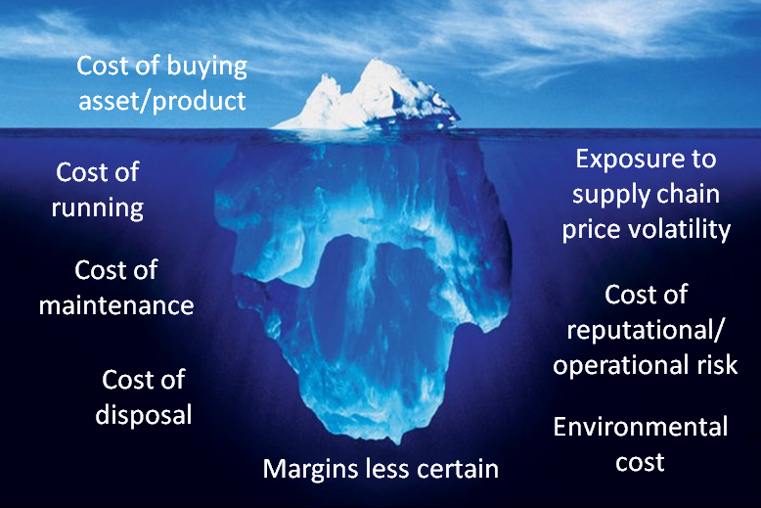
Uncovering hidden contract costs
Notes:
Implementing the process and using the tools can help to identify the true cost of procurement (e.g. through whole life costing). Costs are often hidden and therefore not considered actively at the start of the procurement exercise.
Where savings might be achieved:
Measuring consumption and waste
Consistent operating methods/reducing consumption
Procurement practises
Asset management and re-deployment of assets across the business
Refurbishment v replacement
End of life solutions
Across the business in key functions like:
cleaning, catering, maintenance, office management, security etc

Slide 9
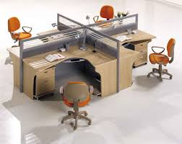
Furniture re-use
Rethink the need
Reduce
Re-use
Recycle
Perth & Kinross Council
Year | Expenditure
09/10 | £292k
10/11 | £131k
11/12 | £61k
12/13 (projected) | £33k
Energy recovery
Notes:
After attending Marrakech Approach to SP in Scotland, Perth and Kinross Council applied the principles of procurement hierarchy to their procurement of furniture.
Resulting in considerable reduction on expenditure on furniture year on year from almost £300k to just 10% of this figure over a four year period.
Also mention that furniture remodelling is gaining market share / popularity as organisations take existing furniture and either refurbish them (cleaning, repair) or remodel them, a good example of this is where office space is to be populated by more staff, perhaps as a result of estate rationalisation, and the current desks are too large, they can be cut down to provide smaller work stations and therefore fit more desks per sq ft than previously possible. Premier sustain offer this service as well as many others.
If purchasing new furniture, consider whether re-modelling may be required in the future and procure with this in mind.

Slide 10
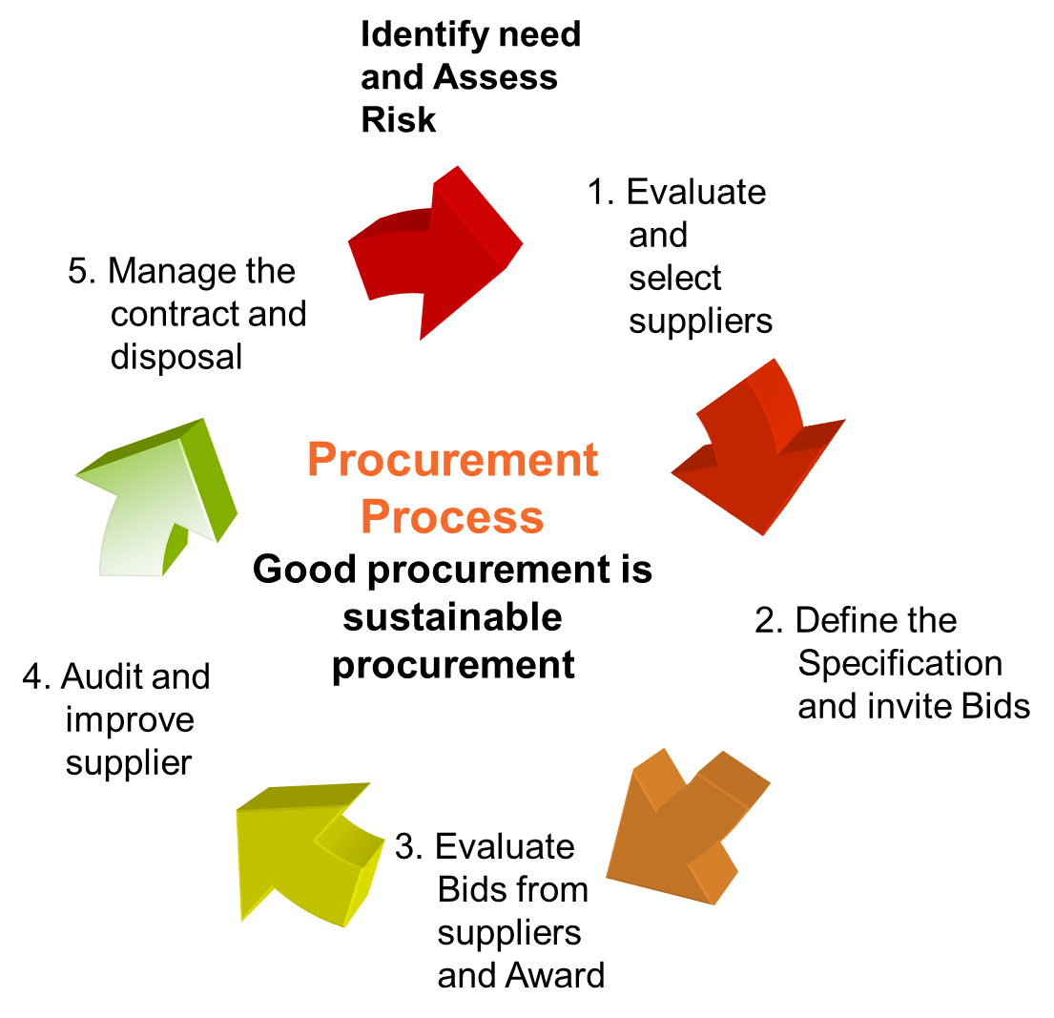
Assuring sustainable procurement policy
Notes:
We need to turn the issues and policy priorities into practical actions for procurement and commissioning
2 main tools:
Risk-based assessment across spend areas (Prioritisation Methodology)
Procurement and Commissioning Cycle and actions that can be taken at each stage
The more relevant the Procurement Policy and Strategy is to the organisation’s priorities including social, economic and environmental wellbeing (as well as efficiency and effective use of resources), the more Procurer’s can reflect those priorities in the commissioning and procurement process.
BUT – it is important to emphasise that the process requires consideration of how best to assure those priorities at every stage in the cycle.
10

Slide 11
Identify sustainability issues
Environmental
Socio-Economic
CO2 and methane emissions
Other air emissions
Emissions to water
Waste to landfill
Hazardous substances
Materials
Energy
Other natural resources
Water
Biodiversity
Local environment
Health
Education
Employment
Community
‘Developing world’ supply chains
Diversity
Other socio-economic
When using this method, identify the issues that are
important for each authority
Notes:
As the earlier table showed, we need to identify the range of sustainability issues that are of importance to the procuring authority
BUT we must emphasise that when you do this back at your own Institution you must relate to the sustainability issues important to your organisation.
Requirements will vary between ministeries and will certainly be different between municipalities and States across Brazil given it’s size and geography.
This will be the basis for ‘how to address sustainability issues through procurement and commissioning’ but we need to find a way to focus on priorities.
Can’t do everything at once – and should not try!
So we need to look at prioritisation first.
11

Slide 12
Prioritisation methodology
Amount of Spend
Risk Score
Influence on Suppliers
Scope to do More
Spend: Environmental: Socio-Economic :Existing Activity: Scope to do More: Reputational: ‘Overall risk’ Score
Structured approach to assessment of categories of spend:
  Amount of spend
  Risk
  Scope
  Influence
Aims to provide a standard approach across the public sector
Focuses effort in areas with the greatest potential to improve sustainability
Notes:
The prioritisation methodology is aimed at procurers who are often faced with limited time and resources, so they need to focus their attention. The methodology needs to be run with a group of stakeholders – it is not designed to be carried out by individual’s working alone.
Prioritise Action
A score is determined for each of the spend areas for risk. These are mapped individually against a matrix to determine the overall priority and the approach to management.
Add the different score for the different risk elements:
Spend – out of 5
Environmental impact – out of 5
Socio-Economic Impact – out of 5
Existing activity – out of 3
Scope to do more - out of 3
Reputational risk – out of 3
This gives a maximum total risk score of 24
It provides a standard approach but different outcomes across different procurement authorities and different levels of government.

Slide 13
Risk based UK (market) approach
23
Construction -
Building & Refit
Food & Drink
Construction –
Highways & Local Roads
SECURE
CRITICAL
Health &
Social Care
Energy
Construction, Maintenance & Operations
Chemicals
Waste
Textiles
Risk
Motor
Vehicles
18
Furniture
Office machinery & computers
Pulp & Paper
Telecommunications, Radio, TV
Pharmaceuticals
Consumables -
White Goods
Business Travel
–
ACQUISITION
COST DRIVEN
11
IT & Computer Services
0
£1bn
£21bn
13
Spend
Notes:
This matrix details each of the key spend areas (so-called UK Top Ten list) in the UK public sector, based on the assessment carried out by the UK SPTF, the total expenditure and its total risk score. As they are precise numbers, it is possible to position each spend area specifically against the matrix.
Critical spend areas: Manage closely, focus on driving value and minimising risk with the supplier but build an effective relationship
Secure spend areas: Manage closely, consider paying cost premium to manage risks associated with the purchase
Cost Driven spend areas: Manage assertively, lever savings from suppliers and use savings to fund costs in higher risk areas.
Acquisition spend areas: Put most efficient measures in place to manage these areas
Buyer Approach
Buyer approach to scope and risk is slightly different. Here, the matrix contrasts risk and scope to determine the focus and general priority the spend has in relation to all other expenditure areas within an organisation. The four categories become:
Transform: Aim to transform the way this product/service is produced and delivered. Aim here is to change the mindset of both buyers and suppliers.
Campaign: Try to motivate suppliers to change production processes/supply chain practices. (This may need support from other stakeholders, including Government).
Quick Win: Set minimum standards and mandate them.
Marginal: Spend time here only if suppliers present opportunities.
13

Slide 14
Risk management options
Re-think need to reduce the risk
The risk cannot be managed through procurement
Addressed in the specification
Managed by choice of supplier
Supplier provides proposals for evaluation (bid evaluation)
Managed by targets to be delivered after contract award
Notes:
We also need to consider where risk can best be managed.
The first step is to re-think the need to purchase.
Risks that can’t be managed through procurement: the identification of risks may reveal some risks that arise from the way the organisation operates. So these risks are best managed through, for example, changes in organisational policies or ‘rules’.
For example, changes in organisational policy on home-working will affect the need for office equipment, ICT, furniture and consumables.
14

Slide 15
Identifying the need
Before engaging with the market:
What we are doing and why?
Needs and ‘wants’
Opportunity to build sustainability into contract from the very start of the process
Challenging – in a positive way
Who is involved?
  role of procurers and commissioners
Now and in the future?
Notes:
The last slide highlighted rethinking the need to reduce the risk. This should be considered BEFORE ENGAGING WITH THE MARKET:
Focus is on earliest possible stages of procurement – when requirements are being identified. Not usually done by procurement (alone).
Emphasise difference between what people ‘want’ and what they really need to satisfy their requirements e.g. alternative ways of meeting that need are likely to be available – but may not routinely be considered.
Procurers may be called upon to challenge internal customers and users – this has to be done in a positive way e.g. offering alternative solutions.
Increasingly commissioners of services are likely to be involved in this process and should be engaged from identification of need through contract management.
One challenge here is to think about the needs of the organisation in the future i.e. not repeat buying, but re-formulating requirements. Particularly important in light of local procurement arrangements, collaborative procurement, etc.
Working with potential suppliers to gather intelligence on what alternatives a market may be able to provide will enable options to be assessed and to explore the possibilities of meeting the need in a more sustainable way.
15

Slide 16
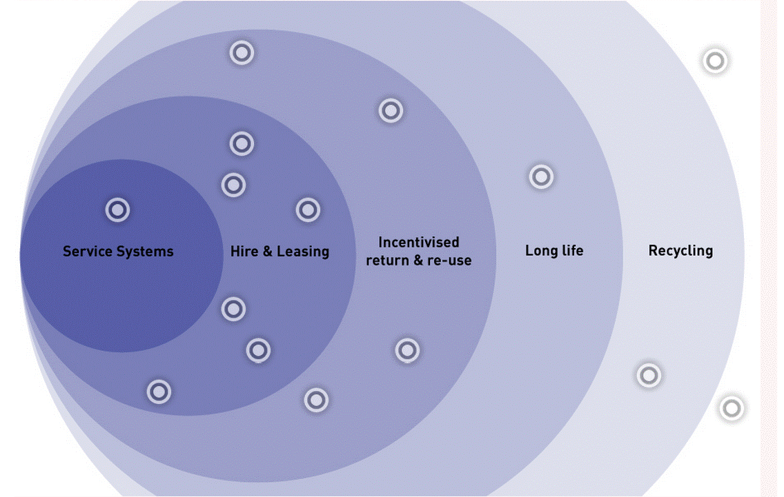
Resource efficient models
Notes:
One aspect of alternative business models is the development of products that have a lighter reliance on resource use.
REBMs can be encapsulated in the concept of sustainable design, that is...
Use less resource / reduce the use of scarce resources / source alternative components made from recovered resources - Reduce materials costs
Recover materials at the end of life: needs less prospecting / more concentrated resources / less reliant on political or supply chain risks
Design to reduce use of consumables: e.g. water, detergent, power etc. – also reduces cost of use.
Design and document to support recovery of materials – e.g. Maersk ships!
Design for longer lifetime / more cycles – e.g. Reusable household cleaner packaging and ISE washing machines designed to work for 8,000 cycles.
The dots on the slide relate to examples that WRAP has developed or is working with the market place to deliver as case studies.

Slide 17


REBMs: textiles & carpets
=
Objectives
Implementation
Outcome
Improve energy efficiency
Adopt renewable energy technologies
Alternatives to petroleum – based raw materials used
Renewable and recycled materials used
Less manufacturing waste
Attic stock requirements eliminated
Eliminate waste
Transport people & products more efficiently
Innovative design of entopy & tactiles products
Tactiles – less waste, low VOCs & greater savings
90% lighter environmental footprint
With the contribution of the LIFE financial instrument of the European Community
www.rebus.eu.com
Notes:
Interface has sales in 110 countries and manufacturing facilities on four continents. By utilising innovative design methods, Interface has moved closer to their goal of designing and manufacturing sustainable closed loop products. Analysis tools like Life Cycle Assessment (LCA) provide valuable information on products’ impacts. The company have also developed strategies for dematerialization and the use of recycled materials to reach it’s goal of sustainable products.
Objectives
Improve energy efficiency, adopting renewable energy technologies, eliminating waste, reducing facility impacts and transporting people and products more efficiently
Implementation
Finding alternatives to virgin petroleum-based raw materials. Interface is exploring ways to increase the use of renewable and recycled materials in all components and products.
In 2007, Interface became the first carpet manufacturer to implement a process for the “clean separation” of carpet fibre from backing, allowing for a maximum amount of post-consumer material to be recycled into new products with minimal contamination.
Outcome
New products result in as little as 1.5% waste compared to as much as 14% for broadloom carpet.
TacTiles are small adhesive backed squares that adhere carpet tiles securely together to form a floor that “floats” for greater flexibility, easier replacement and an environmental footprint that is over 90% lighter than that of traditional glue adhesives.

Slide 18
Influencing the market
Demand Management
Supplier Development
Supplier Capability
Sustainable Outcomes
Sustainable Criteria
Tender Process
Assess Need
Specification
Supplier
Selection
Evaluation
Contract
Management
Influence
Time
The greatest impact can be made in the early stages of procurement and commissioning. Note the opportunities during the life of the contract too.
Adapted from Forum for the Future
18
Notes:
To maximise positive outcomes work with the client or commissioning department, to ensure as many high performing ‘quality’ aspects relating to relevant ‘sustainability’ criteria are integral to the subject matter of the contract.
For example: if the issue of low-carbon is a priority, carbon-free products or services should have a key loading right from the start. Characteristics and criteria, relating to many of these quality criteria can be presented clearly as pass / fail criteria, and are essential for suppliers to meet the Pre-Qualification stage.
However, conditions whereby suppliers agree to work to meet higher performing standards can be built in and evidence of their understanding, commitment and capability to demonstrate this, or do this in future can be tested out again at PQQ stage and followed through in method statements, later on in the process and part of the supplier contract management conditions, as part of ’supplier development’. Supplier development therefore needs to be part of market engagement.
During the lifetime of the contract there are opportunities to deliver sustainability improvements. Contract conditions can be used for mutual benefit, e.g. Reducing emissions; energy efficiency; increasing recycling rates. Opportunities to drive improvements during the lifetime of the contract should not be neglected – and need to inform the development of the entire contractual relationship. This is increasingly important with the growth in long-term contracts. These requirements can’t just be ‘bolted on’ at the end – they need to be considered well in advance – so that conditions of contract can be worded appropriately and/or relevant Key Performance Indicators can be developed.
18

Slide 19
Role of specifications
Technical:
+
Need to be a technical expert
Detailed explanation of requirements
Tell the market precisely what you want
Get precisely what you specify
-
Risk is you get it wrong!
Easy to evaluate
Little opportunity for innovation
Performance:
Define performance parameters
  e.g. office heating/cooling
Great scope for variation
Maximises innovation
More difficult to evaluate
Think carefully about bid evaluation
Notes:
The way requirements are specified can play a key role in influencing markets and service provision. Here’s a brief look at technical versus performance based specifications.
N.B. under EU law any technical specification must not discriminate against other Member States.
Pros and cons of technical specifications should be discussed briefly.
Selecting the right suppliers matters
Suppliers control and manage many key impacts
Own manufacturing / service processes
Their own procurement
It is important to select suppliers who are able to address sustainability considerations – particularly where many of the major life cycle impacts are found in the manufacturing and logistics stage of the life cycle.
Performance based specifications can encourage innovation from the market and lead to more sustainable outcomes if managed properly - - particularly in long term service contracts.
19

Slide 20

REBMs: local SME case study
Use of discarded fruit and vegetables
=
Objectives
Implementation
Outcome
Highlight the volume of food wasted in UK
Create employment for people with limited opportunities
Buy up left over fruit and vegatables from market traders
Employ vulnerable women/adults to help create the preserves
Small stall at Borough Market in London
Looking to expand to sell in high-end supermarkets
Named as one of the
’Top 50 Radical Businesses’ by The Guardian
Employment opportunities
With the contribution of the LIFE financial instrument of the European Community
www.rebus.eu.com
Notes:
Here is one small UK dexample of a council in London that used perfrmance based specifications to encourage innovation and get a more sustainable outcome.
The New Spitalfields wholesale fruit and veg market in London is a publically run facility. A small business called Rubies in the Rubble have set up a purpose-built kitchen onsite. This means they are ideally situated to intercept any unsold surplus directly, transforming it into chutney as soon as it becomes available at the end of the day. And there’s plenty of it: 700,000 tons of fresh produce passes through this market every year, producing over 200 tons of general waste per week.
This has created jobs, reduced waste to landfill and the associated carbon footprint. It also ensures that the embodied energy and calories in the original production of the fruit and vegetables is not all lost from farm to fork.

Slide 21

Risk assessment & supplier selection
Supplier selection (and evaluation) criteria should be informed by:
  risk assessment
  opportunity assessment (scope)
  influence assessment
Notes:
Importance of market intelligence – knowing what the market can deliver in terms of suppliers’ own capabilities – including sustainability.
Nature of the marketplace is important – maturity, degree of competition, etc.
UK marketplace and Brazilian marketplace are very different but the principles of understanding local national and international markets are the same
21

Slide 22
Supplier evaluation
Are any criteria more important than others?
  relevance and proportionality
  award points against each of the criteria and apply weightings (if appropriate)
Establish a scoring model
  better to use fewer key questions
  simple scoring system (e.g. pass/fail)
Finalise selection model in advance
Can only score on information provided
Establish total marks for each supplier:
  aim to differentiate suppliers
  avoid personal preferences
  team approach to evaluation
  remember to compare scores and the benefit of moderation
Notes:
The selection model must be finalised before bids are invited.
Avoid the danger of attempting to score on what is known about bidders, rather than on the information provided.
Scoring system must be made known to bidders in the ITT (or PQQ – pre-qualification questionnaire).
Participants should be asked to describe the composition of their evaluation teams.
22

Slide 23
Supplier approach
Notes:
We need to recognise that the market has its own agenda and you will be part of that in some way! So need to manage in a positive way.
An organisation can become more attractive when sustainability objectives are aligned, this is something buyers may not have considered e.g. Reputation of working with a progressive authority especially if they have a high national/regional profile.
23

Slide 24
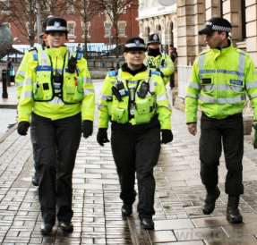
Managed services
e.g. corporate uniforms
Board approval
Tender
Demonstrate financial viability
Evaluate procurement options
Re-think the need
Notes:
Through WRAP’s voluntary clothing commitment (SCAP), one of the members decided to reconsider how they procured staff uniforms. Typically each site was responsible for the procurement of their own uniforms, maintaining stock levels, issuing and receiving back uniforms. Through rethinking the need, they identified a number of procurement options and through evaluating each one it was proposed that uniforms should be leased or rented from the provider – as opposed to outright purchase - but they then took this one step further and identified that procuring a managed service would deliver further economic, environmental and social benefits.
WRAP developed a costing model which was used to demonstrate to the Board and also potential bidders that moving to a managed service would not only create cost savings for the organisation, but be a financially attractive proposition for perspective tenders. This formed part of the due diligence phase of the procurement and following agreement, was approved by the board.
This example demonstrates that re-thinking the need enabled the organisation to stop what it had always done, analyse the procurement opportunities and based on their influence over the market, propose and now proceed with an alternative business model which will deliver sustainability savings:-
Cost savings – through collaborative procurement across all sites, the initial upfront saving from procuring to leasing and on-going cost savings per item purchased.
Environmental – vehicle movements will be reduced and old uniform will be returned for re-use and / or repair.
Social – employment opportunities through the award of contract to the service provider, free’s up organisations resource to spend time on other, perhaps more deserving activities.

Slide 25
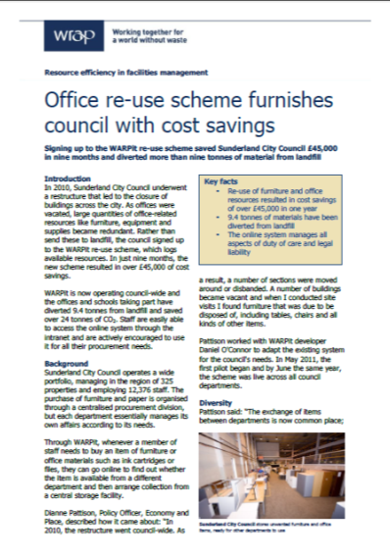
Client benefit example
Council restructure in 2010 led to office closures
As a result, the authority had large quantities of good quality, unwanted furniture
Re-use scheme delivers £45,000 cost savings in 9 months

Slide 26
Stakeholder engagement
Procurement and commissioning stakeholders include:
Internal customers
Users of service
Commissioners
Specifiers
Suppliers and contractors
Elected members
Non-governmental organisations
Specialists
Others?
Notes:
Engaging with the market is an important part of stakeholder management as my presentation has shown. However, the slide shows there are other stakeholders to consider - Is this everyone?
Remember that procurement and commissioning are part of ‘big picture’ procurement and we therefore need to ensure that procurement people not just understand this but they also make it happen in practice and see the results of their actions. They are also a critical stakeholder!
So I leave you with a question for your authority, organisation, department or budget - what needs to happen to make the delivery of SP easier and more effective and in order to realise the benefits?
Here are some links while you think………………………………….
26

Slide 27
Some further links
Guidance on how to develop a sustainable procurement policy and related documentshttp://www.wrap.org.uk/content/sustainable-procurement
E-learning - http://www.wrap.org.uk/content/sustainable-procurement-e-learning-modules
Procurement wording for key categories – these are embedded in the e-learning, the last modules in each category
Facilities Management tools & guidance (e.g. toolkit): http://www.wrap.org.uk/category/sector/facilities-management
Zero Waste Scotland e-booklet and related documents: http://www.zerowastescotland.org.uk/scotlandprocurement
Notes:
Over the past 18 months WRAP has worked with public sector clients in the UK to deliver cost and resource efficiency savings through the procurement of service contracts to the value of ~£5.3bn.
To date this support has resulted in WRAP influencing ~70 contracts, including catering, maintenance, furniture, and Total service contracts.
The estimated impact (based on data for those supported) over the life of the contracts will be ~125,000 tonnes of waste prevented with total savings in the order of £39 million.

Slide 28
Thank you
Dr Mervyn Jones
mervyn.jones@wrap.org.uk
www.wrap.org.uk
Notes:
Obrigado pela atenção....... Thankyou for listening

